Slide 1
BASIC HEMODYNAMICS: PRESSURE MEASUREMENT & NORMAL PRESSURE TRACINGS - PART II
Dr Harikrishnan G

Slide 2
PULMONARY CAPILLARY WEDGE PRESSURE
Obtained by inflating the balloon-tipped catheter in the distal PA position until it occludes the PA branch
Represents the LA pressure
Notes:
Stagnant column of blood beyond balloon
This column has equal pressure of Pulmonary vein and LA

Slide 3
23mmHg
20mmHg
Mean PCWP≈12mmHg

Slide 4
PCWP Vs Actual LA Pressure
Mean PCWP = Mean LA pressure
PCWP is delayed 50-150 ms to that of LAP
Smoother contour: less deep X and Y descents (Damping)
Normal PCWP: </= 12 mmHg
Notes:
1. Delay is due to delay in transmission retrogradely from LA to branch Pulm A

Slide 5
PITFALLS IN INTERPRETING PCWP
Normally: mean PCWP ≤ PA diastolic pressure
This relationship is maintained in most disease states
Pulmonary venous HTN: PCWP ≈ Diastolic PA pressure
Pulmonary artery hypertension: PCWP ≤ Diastolic PA pressure

Slide 6
PITFALLS IN INTERPRETING PCWP
In severe decompensated MR→ PCWP ≥ PA diastolic pressure

Slide 7
However, mean PCWP ≥ diastolic PA represents
A damped PA pressure tracing
Catheter’s being wedged in zone 1 or 2 of the lung

Slide 8
Wedging in zone 1 and 2, PCWP reflects the alveolar pressure rather than capillary pressure
PCWP then will have larger respiratory swings
It can be higher than PA diastolic pressure
level below the LA level on a 90 degree lateral view
PA catheter should ideally be wedged in Zone 3

Slide 9
Zone 1 and 2 expands in case of mechanical ventilation (increased PEEP)
Or in Low LA pressure )(hypovolemia)

Slide 10
2. In the setting of PH
Severe PH makes it difficult for the catheter to occlude the PA
Wedged waveform may represent damped PA pressure
Overestimate the true PCWP

Slide 11
Notes:
Pressure peaks during T wave rather than after T wave
Pressure is downsloping in diastole

Slide 12
Severely elevated pulmonary arteriolar or venous resistance
Retrograde transmission of LA pressure is imapired
Damped and flattened PCWP, lacking waves and descents

Slide 13
3. Over wedging
Balloon overinflated or PA catheter positioned too distally
Compression of catheter tip by vessel wall
Over wedged waveform lacks distinct A and V waves
Characterized by continuous rise or continuous fall of PCWP

Slide 14
4. Pulmonary venous occlusion
PCWP often equals Pulmonary capillary hydrostatic pressure (Pcap)
Pulmonary venous obstruction→ Pcap-elevated
PCWP would still represent LAP
Pulmonary edema may occur with normal PCWP

Slide 16
Conditions were PCWP stimulate PA pressure
Presence of large V wave : Severe MR
Severe Pulmonary arterial hypertension
If catheter not wedged properly or Wedging too proximally

Slide 17
How to differentiate PA tracing from PCWP?

Slide 18
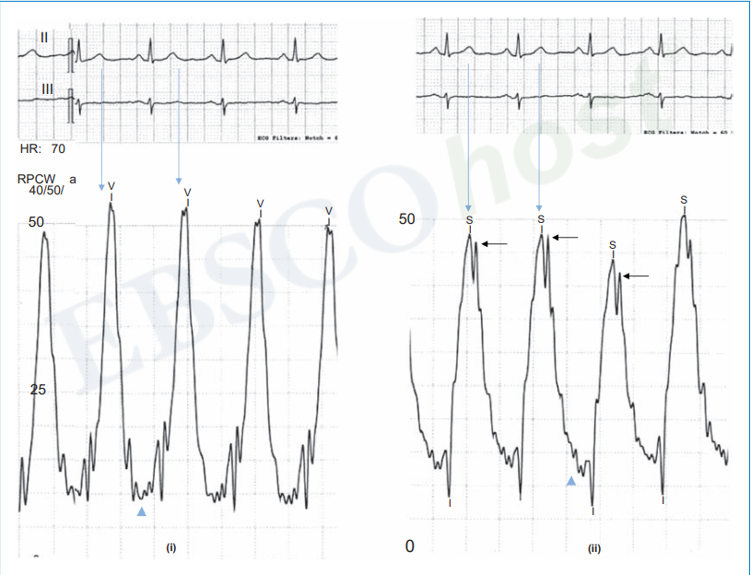
PCWP
PA Pressure tracing
Notes:
Timing
Diastolic pressure is horizontal in PCWP vs Downsloping in PA pressure

Slide 19
PCWP vs PA pressure
PCWP
PA pressure
Tall V peaks after T wave
Segment between V waves→ Horizontal or upsloping
Systolic PA pressure peaks during T
Downsloping

Slide 20
2. Observe during pull back
Change in the timing of the pressure tracing
Change in height of the mean pressure corresponds to diastolic PA pressure
The lack of significant change means that PCWP was actually a damped PA pressure

Slide 22
3.Best method
By obtaining blood samples from wedged catheter tip
PCWP saturation = pulmonary venous saturation (usually >95%)
PA saturation = mixed venous saturation

Slide 23
Abnormalities of PCWP
Large V wave
10 mmHg higher than mean PCWP
Larger than twice mean PCWP

Slide 24
Large V waves
Severe acute MR or decompensated chronic MR
Decompensated LV failure with impaired LA compliance
VSD
MS
Atrial fibrillation

Slide 25
PCWP in Decompensated LV failure
High PCWP with early diastolic gradient between PCWP & LV pressure
This gradient= Large transmitral E wave= LVS3

Slide 26
Large a wave
Impaired LV compliance
Early course of MS

Slide 27
LV PRESSURE TRACING
LV systolic pressure is equal to the aortic systolic pressure
A gradient between LV systolic pressure and aortic pressure is seen in case of AS

Slide 28
LV diastolic pressure tracing

Slide 29
Gradient= E velocity on echo
Early diastolic filling
Correspond to A velocity in doppler
Small dip in early diastole
Drives early filling
Notes:
Purticularly seen in young patients: compliant LV
Unless the patient is in AF, LV tracing has A wave

Slide 30
Normal E/A = 0.8 – 1.5
Ventricular relaxation= E’ on tissue doppler (annular velocity)

Slide 31
LVED
Has an A wave corresponding to atrial a wave
Diastolic phase will be horizontal or upsloping

Slide 32
LVEDP
Located at downslope of LV A wave
At the crossing of LA and LV pressure
Immediately precedes LV IV contraction
LVEDP>mean LV Diastolic pressure
Serve as a surrogate of LV function
LVEDP>16mmHg→LV dysfunction

Slide 33
In patients with hypercompliant LV (Young patients)
E/A > 1.5
Physiological S3
High E’ → “super” recoil

Slide 34
LV Pressure tracing in HF

Slide 35
LA a wave becomes prominent than v wave
The slope of LV descent is slow
Cumulated blood suddenly rushes to LV during A wave
Rapid rise of LVEDP due to poor compliance
S4 on examination
Poor diastolic filling
Volume of blood cumulates in LA
Notes:
LV diastolic dysfunction characterized by Poor relaxation and reduced LV compliance

Slide 36
Compensated HF
Notes:
LV pressure significantly rises at the end of diastole
Elevated LVEDP despite mildy elevated or fairly normal Mean diastolic pressure
Formation of S4
Lack of LV early diastolic Pressure dipping & Normal LA pressure : reduced E
Large filling during late diastole: increased A→ E/A reversed

Slide 37
Stage-1 LV diastolic dysfunction
Impaired relaxation with compensated LV systolic function
E/A Reversal & E’ reduced
LV diastolic pressure and LA pressure are normal outside LVEDP
Discrepancy between LVEDP and Mean LA pressure (PCWP) is seen

Slide 39
Stage 2 to 4
Increases LA pressure “push” flow in the LV → ↑ E
S3 on examination
LV compliance is overwhelmed
Sharp ↑LV pressure throughout diastole

Slide 40
Isolated S4: loss of LV compliance with ↑ LVEDP but normal mean LV diastolic pressure
Presence of S3: LV decompensation with volume overload of LV, LA and pulmonary capillaries, and a push from LA to LV in early diastole

Slide 41
Decompensated Heart failure
Early diastolic gradient +: due to pushing effect
Elevated LA or PCWP
Sharp increase in LV diastolic pressure: Dip-plateau or sharply upsloping LV pressures

Slide 42
Decompensated Heart failure
E/A > 1.5
IVRT will be reduced
E’ will be reduced

Slide 43
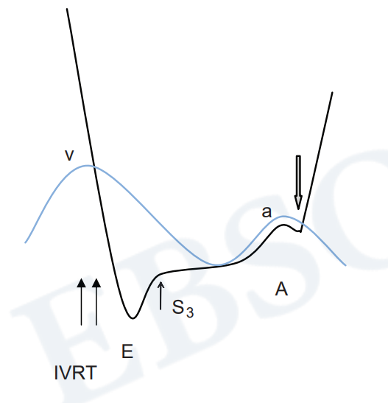
Notes:
In compensated HF → Impaired relaxation and E/A reversal
Decompensate any volume which overwhelm LV compliance
Except for LVEDP, The diastolic pressure outside LVEDP remains low
So, anything decreasing the Diastolic time or Atrial contraction → Decompensate LV
Preventing tachycardia and Re-establishing atrial contraction in AF will help with LV filling at this stage

Slide 44
Notes:
In decompensated HF, LV filling occurs only at early diastole→ due to Push from LA to LV
Except in severe tachycardia (>150bpm), Slowing down HR or reestablishing atrial contraction maynot help
Tachycardia in this case serves to LV emptying
Diuresis , preload and after load reduction is Rx
Once LV gets compensated, Rate control or restoring to SR from AF can be done

Slide 45
LVEDP & PCWP
Normally → Mean PCWP= Mean LA pressure = LVEDP
PCWP < LVEDP → Compensated systolic or diastolic dysfunction, Decompensated severe AR
PCWP> LVEDP
MS
Decompensated MR
Severe PAH
PA catheter wedged in zone 1 or zone 2
Pulmonary catheter wedging in critical illness (sepsis, Hypoxemia)

Slide 46
PITFALLS IN LVEDP DETERMINATION
Using the ACIST system for contrast injection with its built-in pressure transducer the signal tends to be delayed 50 to 100 milliseconds relative to the ECG
All hemodynamic waves are delayed relatively to their usual ECG timing

Slide 47
PITFALLS IN LVEDP DETERMINATION
2. LVEDP varies with Respiration
LVEDP measured at end expiration
Unless patient actively expires, Highest recorded LVEDP point is measured
Notes:
1. There can be observer variation

Slide 48
PITFALLS IN LVEDP DETERMINATION
30mmHg
12 mmHg

Slide 49
PITFALLS IN LVEDP DETERMINATION
3. Contamination of aortic tracings
Movement of catheter with respiration
When using multi-hole pigtail catheter
Few side holes fall into aorta and contaminate LV diastolic pressure
LVEDP fluctuates >15mmHg

Slide 50
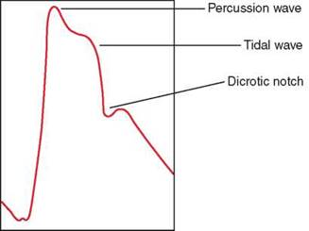
Systemic arterial pressure tracings

Slide 51
Dicrotic limb
Anacrotic limb
Systole
Diastole

Slide 52
Notes:
Aortic upstroke starts normally, but sharply impedes after the valve stops opening
Reduced Stroke volume
AR: Wide pulse pressure, Low diastolic pressure, Bifid pulse may be seen

Slide 53
Notes:
Spike and Dome Pattern: due to late dynamic obstruction in HOCM
Dicrotic pulse: 1 peak in systole, 2nd peak in diastole: Severe LV failure or hypovolemia

Slide 54
Pulsus alternans
Beat to beat alternation in systolic pressure
Severe LV dysfunction & Severe AS
Reduces the inotropism of the next beat
Strong beats leaves a small residual end-systolic volume

Slide 55
Pulsus paradoxus
Gradual fall of systolic pressure >10mmHg during normal quite inspiration

Slide 56
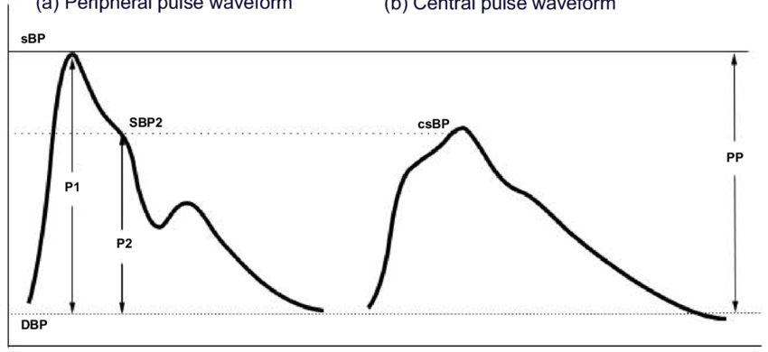
Peripheral pulse amplification

Slide 57
Taller systolic peak
Delayed dichrotic notch
End diastolic pressure: lower
Later pulse arrival
Systolic limb becomes steeper

Slide 58
Practical aspects

Slide 59
Valve stenosis estimation
General principles
Measurement of valve gradient and calculation of valve area
Flow= Area x Velocity Area= Flow/Velocity

Slide 60
In Echo: Doppler interrogation measures Velocity directly
In Cath lab: BY Torricelli law, ie. V= √2gh
g= acceleration due to gravity
h= valve gradient

Slide 61
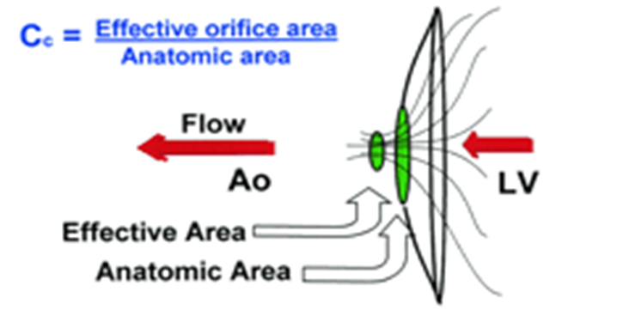
Gorlin formula
A= F/(CC X CV X √2gh)
CC & CV → Coefficient of orifice contraction and velocity loss

Slide 62
Pitfalls of Gorlin Formula
The coefficients have never been determined
An empirical constant to make their calculated mitral valve areas align better with actual valve areas obtained by autopsy or surgery
For the other 3 valves, not even an empirical constant has been developed.
For other valves→ constant kept as 1 (Theoretically impossible)

Slide 63
So Valve area used in conjunction with
Valve gradient
Pressure contours
Contractile state of ventricles

Slide 64
Aortic stenosis
Clinical findings of severe AS + Mean gradient >40mmHg by doppler→
No further hemodynamic assessment is needed
Indicated when there is a discrepancy between clinical findings & echo

Slide 65
Aortic stenosis assessment
Notes:
1. Done by simultaneously assessing Aortic and Ventricular pressures

Slide 66
Notes:
Done by simultaneously assessing Aortic and Ventricular pressures
Peak to peak gradient was used in past- Not physiological
Mean aortic gradient is recommended

Slide 67
Prerequisites
Aortic pressure and LV pressure to be measured simultaneously
Pull back technique with single catheter can be helpful:
In patients with Sinus Rhythm
Simultaneous LV & Femoral pressures shouldn’t be used
Underestimation: peripheral amplification
Overestimation: Large vessel stenosis

Slide 68
Prerequisites
2 separate catheter lumens kept in the proximal aorta before the left ventricle is entered.
The pressures recorded should be matching perfectly
Pressures in aorta to be measured by a side-hole catheter

Slide 70
Dobutamine stimulation
To differentiate pseudo aortic stenosis from true AS
Assessment of ionotropic reserve ( ↑ in stroke volume >20%)

Slide 71
AS VS HOCM
Pull back method

Slide 72
AORTIC STENOSIS

Slide 73
HOCM

Slide 74
Brockenbrough sign

Slide 75
HOCM

Slide 76
Mitral stenosis
Indications: discrepancy between symptoms, transmitral gradient and pulmonary pressure
Gradient assessed by simultaneously measuring PCWP & LV pressure
30-50 % chance of overestimation
Phase shift in PCWP
Delay in transmission of pressure waves

Slide 77
MITRAL REGURGITATION

Slide 78
RCMP VS CCP

